Slide 1
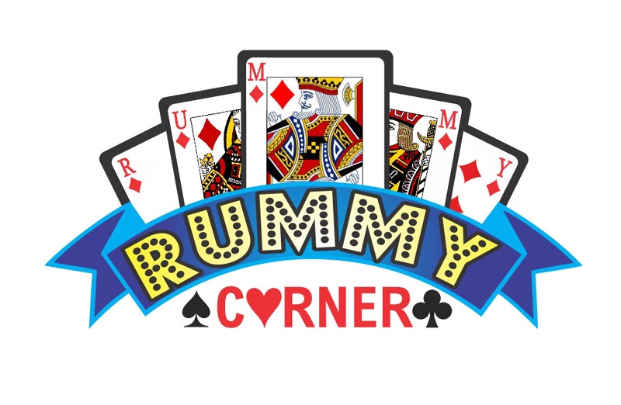
Rummy Card Game
By: Qihong Kuang
Rajat Arora
Felix Chan Lee
Anu Aggarwal

Slide 2
OverView
Introduction
Game-Play
Architecture
Challenges & Solutions
Demo

Slide 3
Introduction
2 player card game
Goal:
Discard all the cards
How:
By melding/laying off cards that are either:
Of same Suit and in sequence
Same number (rank)

Slide 4
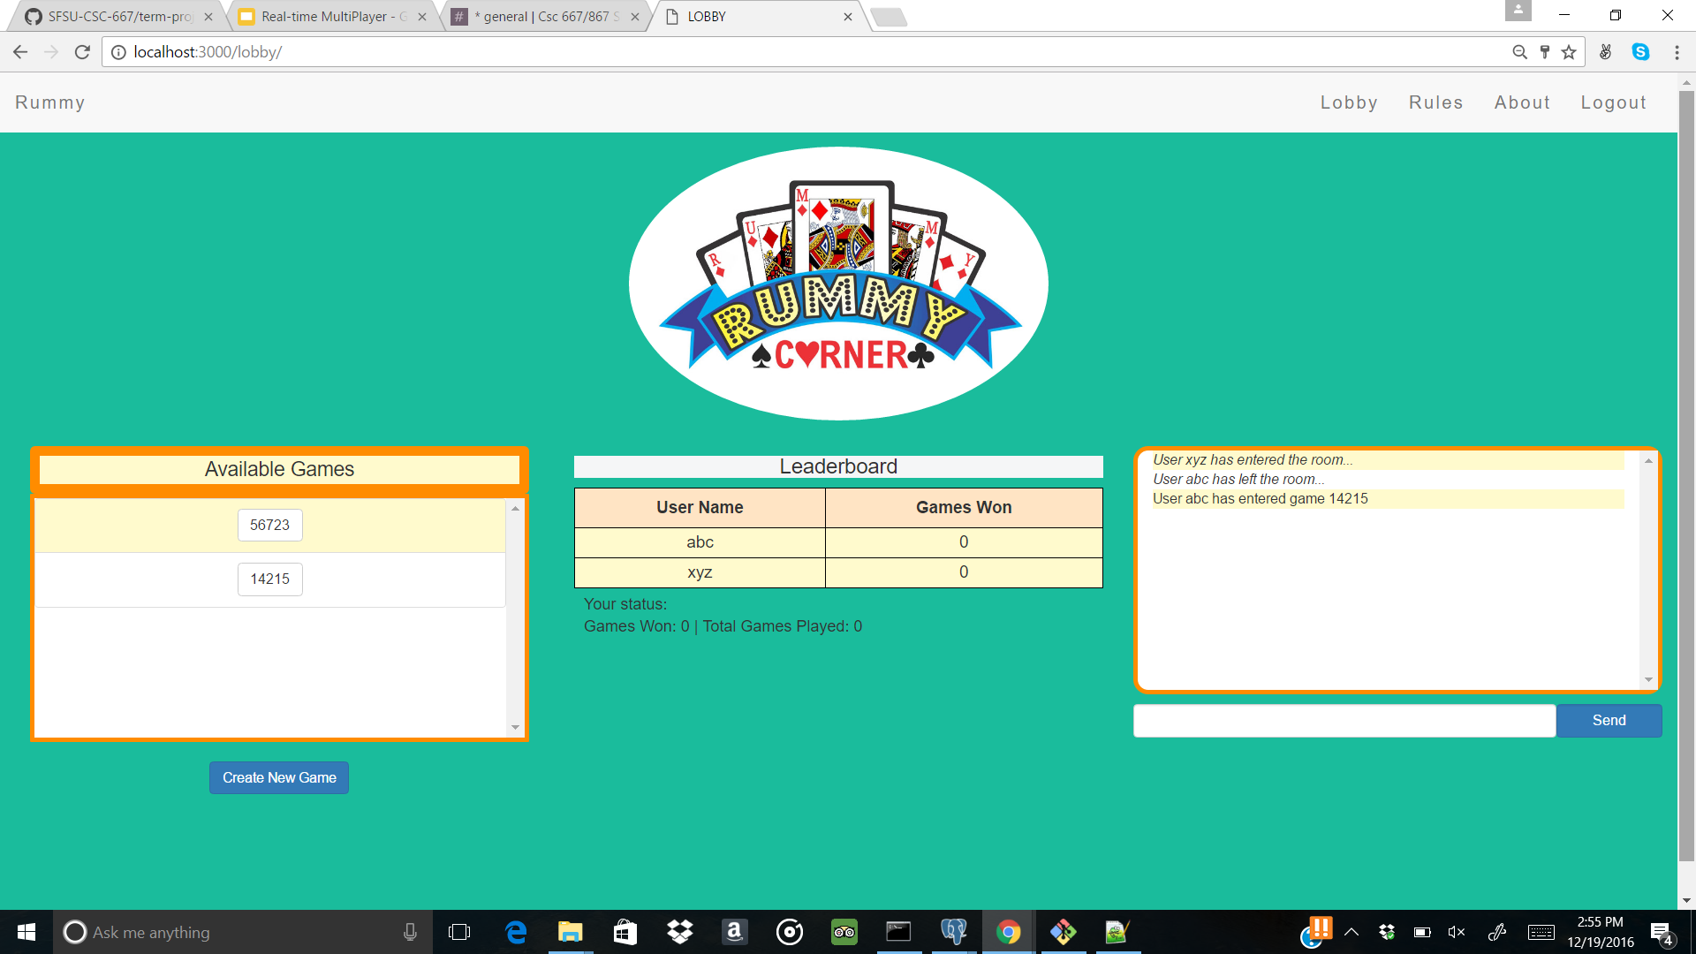
Game Lobby

Slide 5
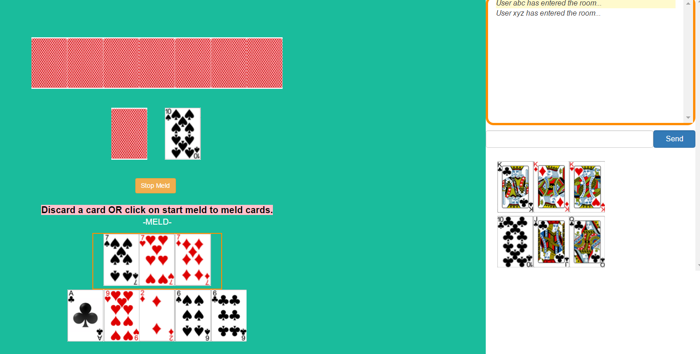
Game Room - Meld
Temporary Melding Area

Slide 6
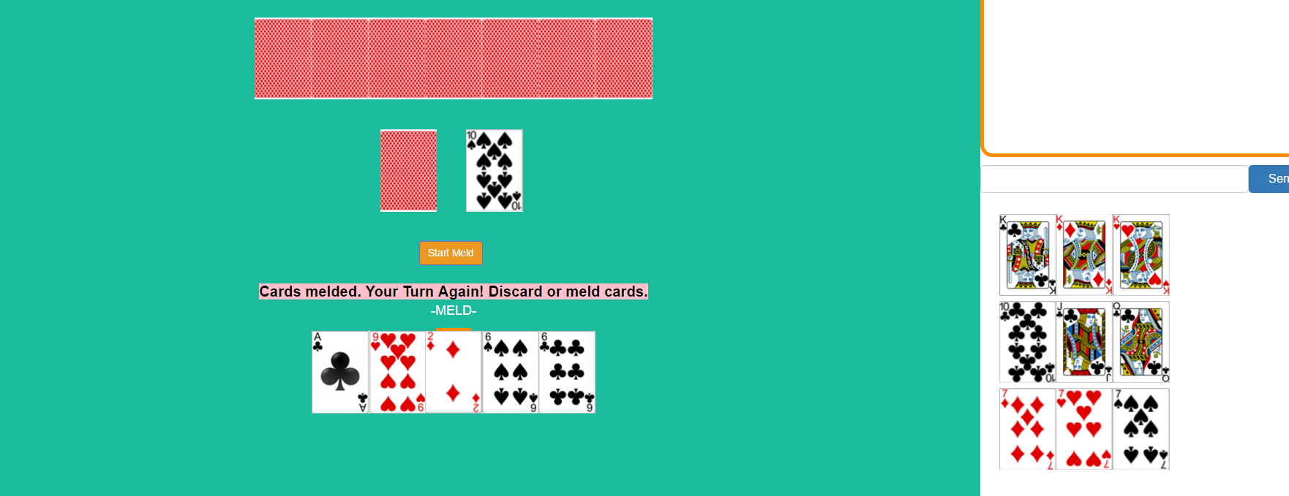
Game room - Meld
Melded cards are placed here

Slide 7
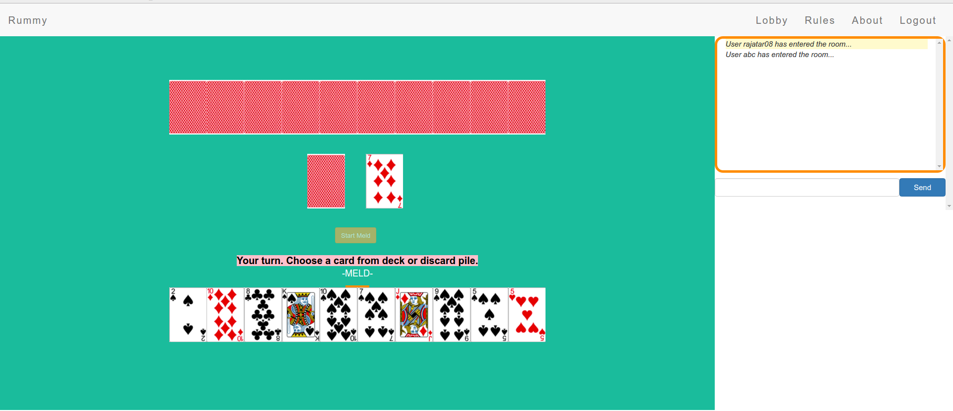
Architecture
NODE [SERVER]
E
X
P
R
E
S
S
PUG Templating
Engine
POST/GET requests/responses
SOCKET IO
Socket Events
PostgreSQL [DB]
Notes:
Pitfalls of this architecture

Slide 8
Challenges
Node.js (GET/POST) vs Socket.io (Events)
Socket rooms and namespaces
Player reconnection with Socket
Cards image sprite

Slide 9
Challenges
Node.js (GET/POST) vs Socket.io (Events)
Problem: Which one to use for game logic?
Solution:
For different routes (‘/lobby’, ‘/login’, ‘/game’) we use POST/GET requests using Express.js
Once game starts (‘/game/:gameId’), we use Socket events for to-fro communication with server

Slide 10
Challenges
Socket rooms and namespaces
Problem: How to implement for our game which has chats on different pages?
Solution:
Namespaces for different chat pages(‘/lobby’ and ‘/game’)
Rooms for different games in ‘/game’ namespace. Eg, (‘/game/:gameId’) :
‘/game’ = Namespace
‘/:gameId’ = Room in Namespace ‘/game’

Slide 11
Challenges
Player reconnection with Socket
Problem: How to revive the game if player reconnects (includes refresh) ?
Solution:
Game state is updated in DB (JSON magic in PostgreSQL)
On disconnect, we pause game for other player
On reconnect, we verify if the player was part of that game. If true, then we refresh the page with last state
If both players disconnect, we remove the game from history

Slide 12
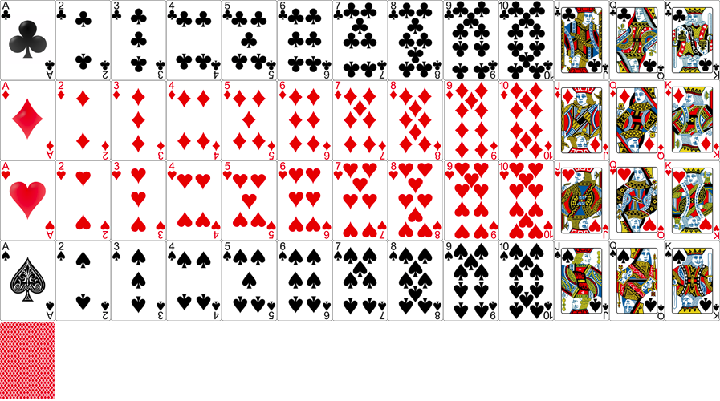
Challenges
Card ID’s are constant in DB and in sync with card sprite image
Cards image sprite
Problem: How to serve 1 card image instead of 53 images?
Solution:
Used card sprite (One image with 53 cards of equal size)
Each sub-image is 69px * 100px and there are 53 of them in one sprite (897px * 500px)
53 css classes are created. In each class, we specify the x-coordinate and y-coordinate of the starting point of each card
For example: Spade 3. The starting of this card is x: -138px y: -300px. Then extend 69px width and 100 height from the starting point

Slide 13
DEMO
https://agile-gorge-78443.herokuapp.com

Slide 14
Thank You!!
Any questions??

